Slide 1

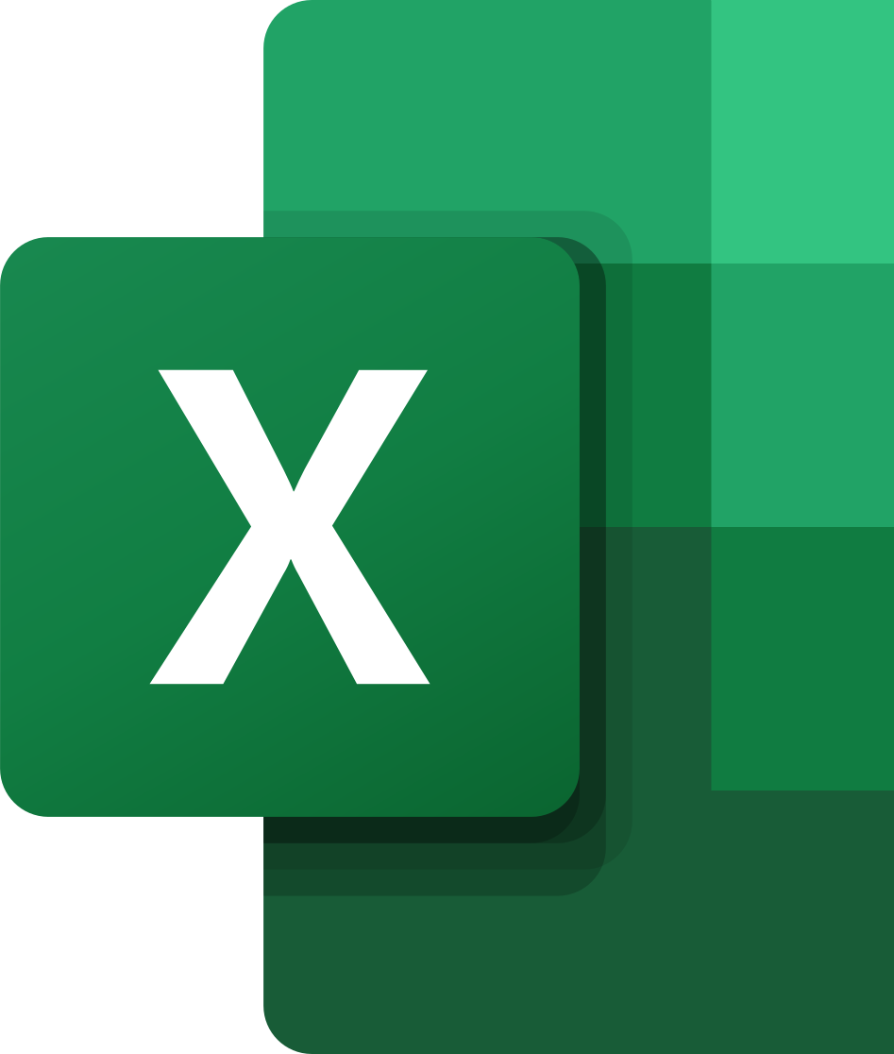
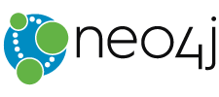
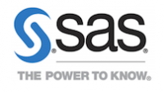
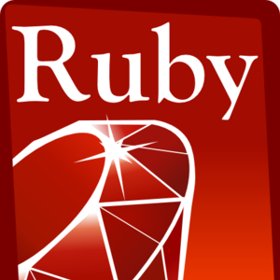


Popular Data Science Tools & Languages
SAS
MATLAB
Excel
Jupyter
MongoDB
Trifecta
Apache Spark
Neo4J
Python
Ruby
R
Scala

